Slide 1
PROJECT PRESENTATION
PROJECT NAME : GPA OFFICIAL APPLICATION
PROJECT GUIDE : Mrs. S. S. Sant
GROUP MEMBERS :
1) Mandale Asha
2) Lahoti Disha
3) Londhe Meghraj
4) Dahake Chandrakala

Slide 2
Why this Project ?
Before taking this project we were searching for other projects.
We selected 3 project titles. Three project title as follows :
Society Management System
Registration website
GPA Official Application
But in 1st project we realize that it is commonly used in huge residencies and in 2nd project the there are many websites who can registers flights, buses, hotels etc.
The 3rd topic was unique because in past no one was developed this kind of project and there was a need for our college which will make everything digitally and without paper work
.

Slide 3
INTRODUCTION
GPA Official app is the android based application which will work on the android devices. It will have the online server which will help for changes that is going to done in real time world.
ex. If admin do some changes or uploads any documents then it will be uploaded to the online server. It will have two logins admin login and user will be able to do changes and user will not able to do any kind of changes. This app will helpful for the diploma students and who wants to do diploma course in future.
In this project we are providing the easy UI for the user so that user can easily serve application. Application will contain the information of the whole college like its gallery, information of all events conducted by college.
To know the result of the exams we are also providing that feature. Students who are searching for the question papers and the answer sheets they will able to download the exam papers and answer papers from the application.

Slide 4
NEED OF PROJECT :
To develop application for college.
It will provide information easily.
It will be convenient and user friendly for user and admin.
It would be all in one platform like all the information which is useful for students like curriculum, question papers, model answer papers etc.
To reduce the paper work of admin.
In this application there is the gallery, staff details, information of events , result and achievements and all information for students like time table, subject teachers etc.

Slide 5
LITERATURE :
Before this project there are so many application like this are available on play store or on websites but somewhat this application is better than that applications because if we consider the other applications will not give you convenient output as expected.
There is application on the play store MSBTE this app will give you only the MSBTE information or the question papers and they don’t have curriculums of some department.
So in this application we have solved all the problems and error which are occurring in the other applications and we are providing the errorless.
We have used online server so the changes will done at run time.
In this project the all needed things are included.

Slide 6
DATA FLOW DIAGRAM
In this flow diagram first there will be a two modules STUDENT and ADMIN.
STUDENT will have only read permission
ADMIN will have read, write and execute permission
ADMIN will be able to make changes in the application like if they want to upload or change any data so they can do it.
Module
STUDENT
ADMIN

Slide 7
Student Module
Information about the department .
The details of the Principal
Gallery includes the photos and videos about GPA like State or Institute level events ,Gathering ,etc…
We have provide the link of various online learning platforms like NPTEL or SWAYAM.
Result contains the semester result link.
Notice Board contains the notices from the college.
Library contains various online books which are available on the Internet.
Department
Principal Desk
Gallery
Online videos
UT Marks
Result
Notice Board
Library

Slide 8
User
Department
Principal
Gallery
UT Result
Notice Board

Slide 9
Computer
Staff
Details of Staff
Class
Curriculum
Question Paper
Subject Teachers

Slide 10
Structure of Development :
CMS
(WP)
Database
Web View
Android

Slide 11
Required Tools and Languages
Hardware Requirements :-
Intel i3 processor 8th generation.
4GB Graphics Card.
8GB Ram.
Android mobile for debugging.
Software Requirements:-
Android Studio.
Word Press (CMS Technology)
Language Required:-
Front-End:- Java.
Backend-End:- SQL lite.

Slide 12
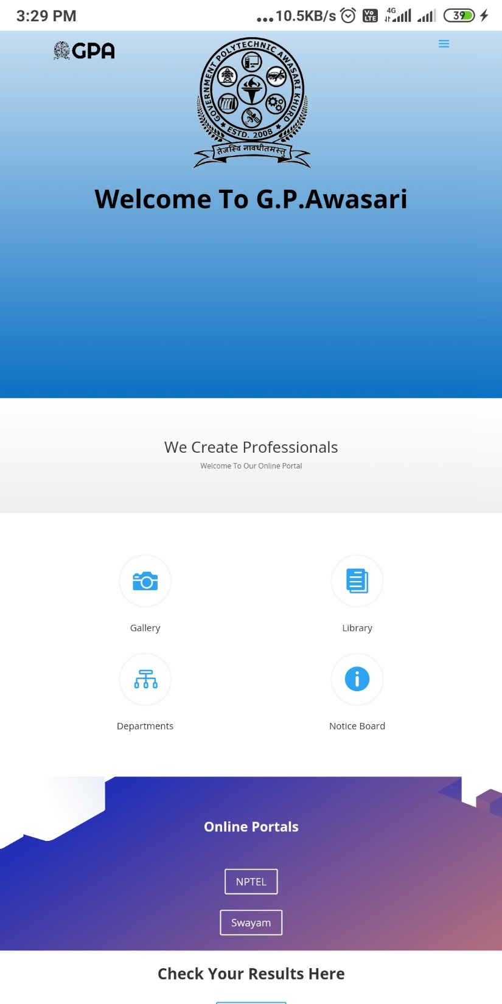
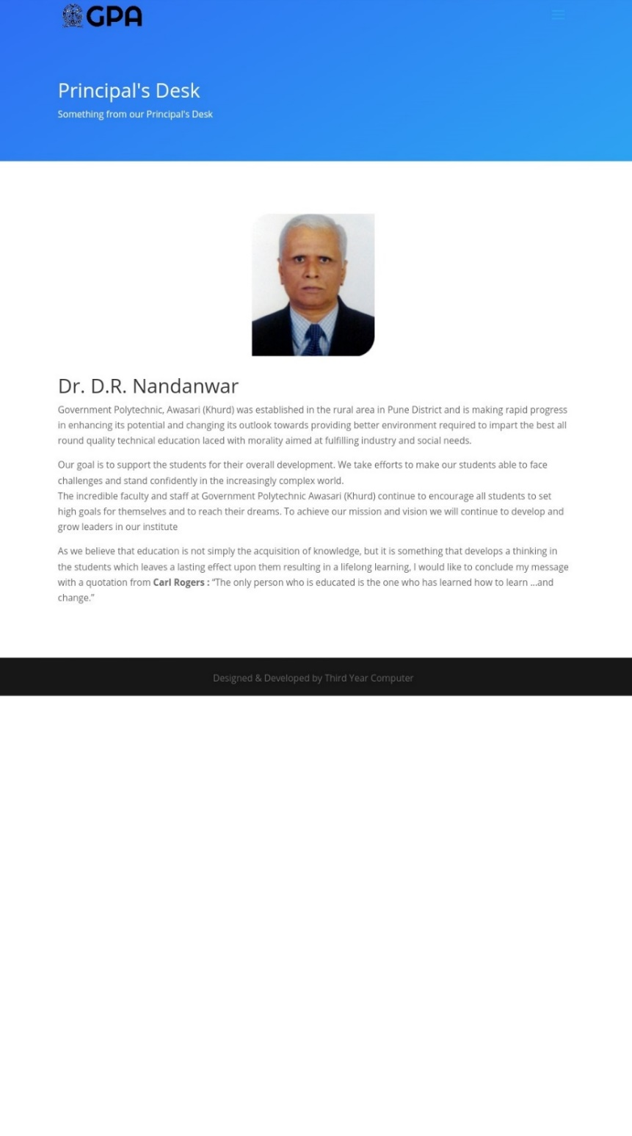

Slide 13
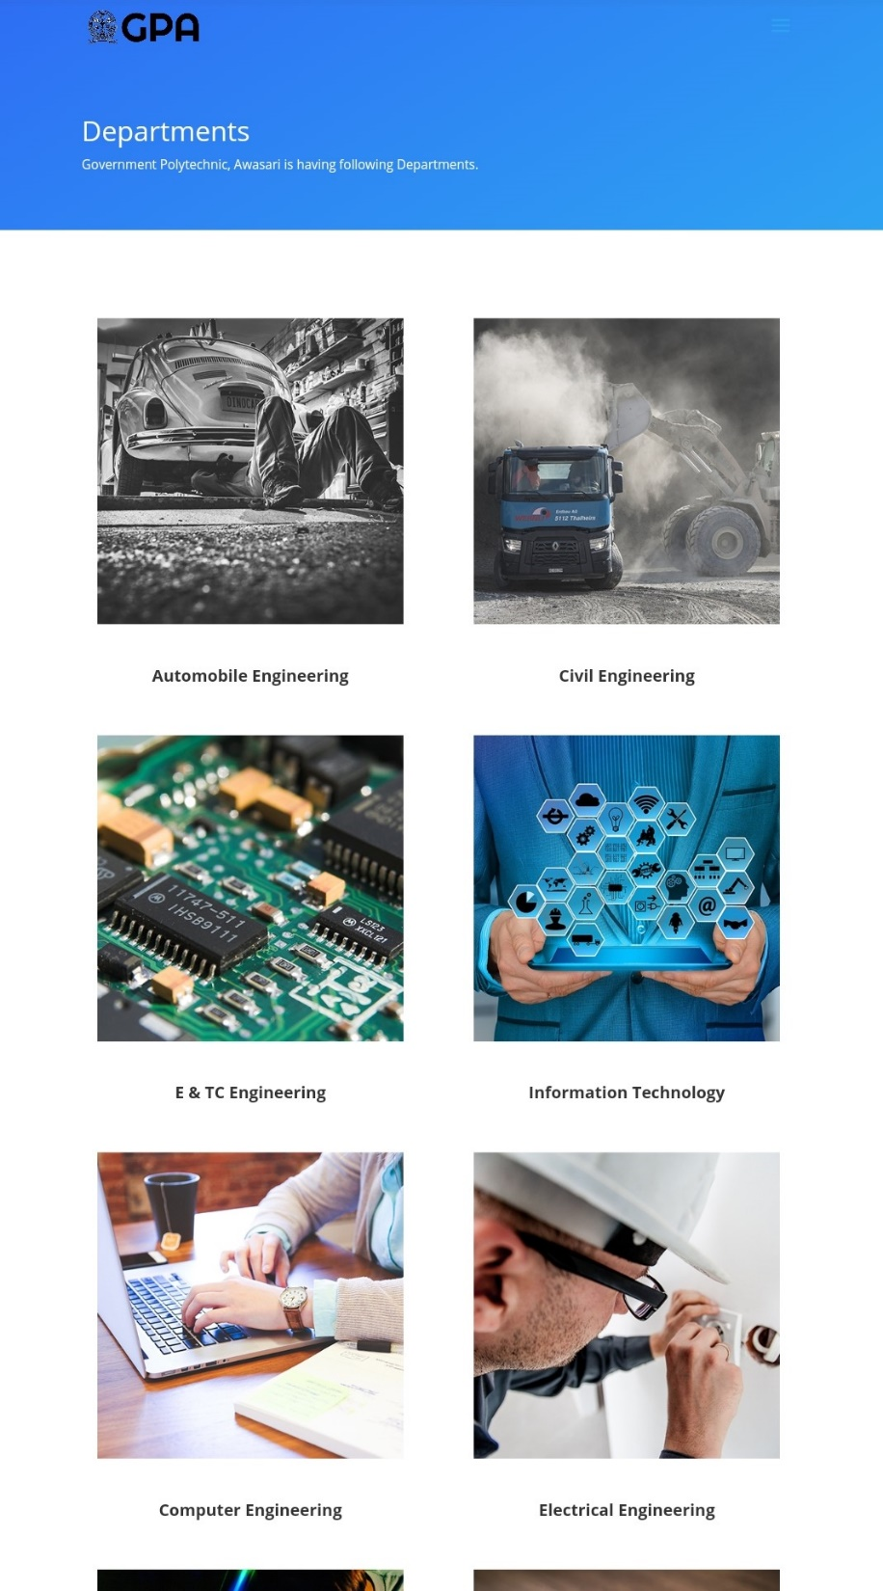
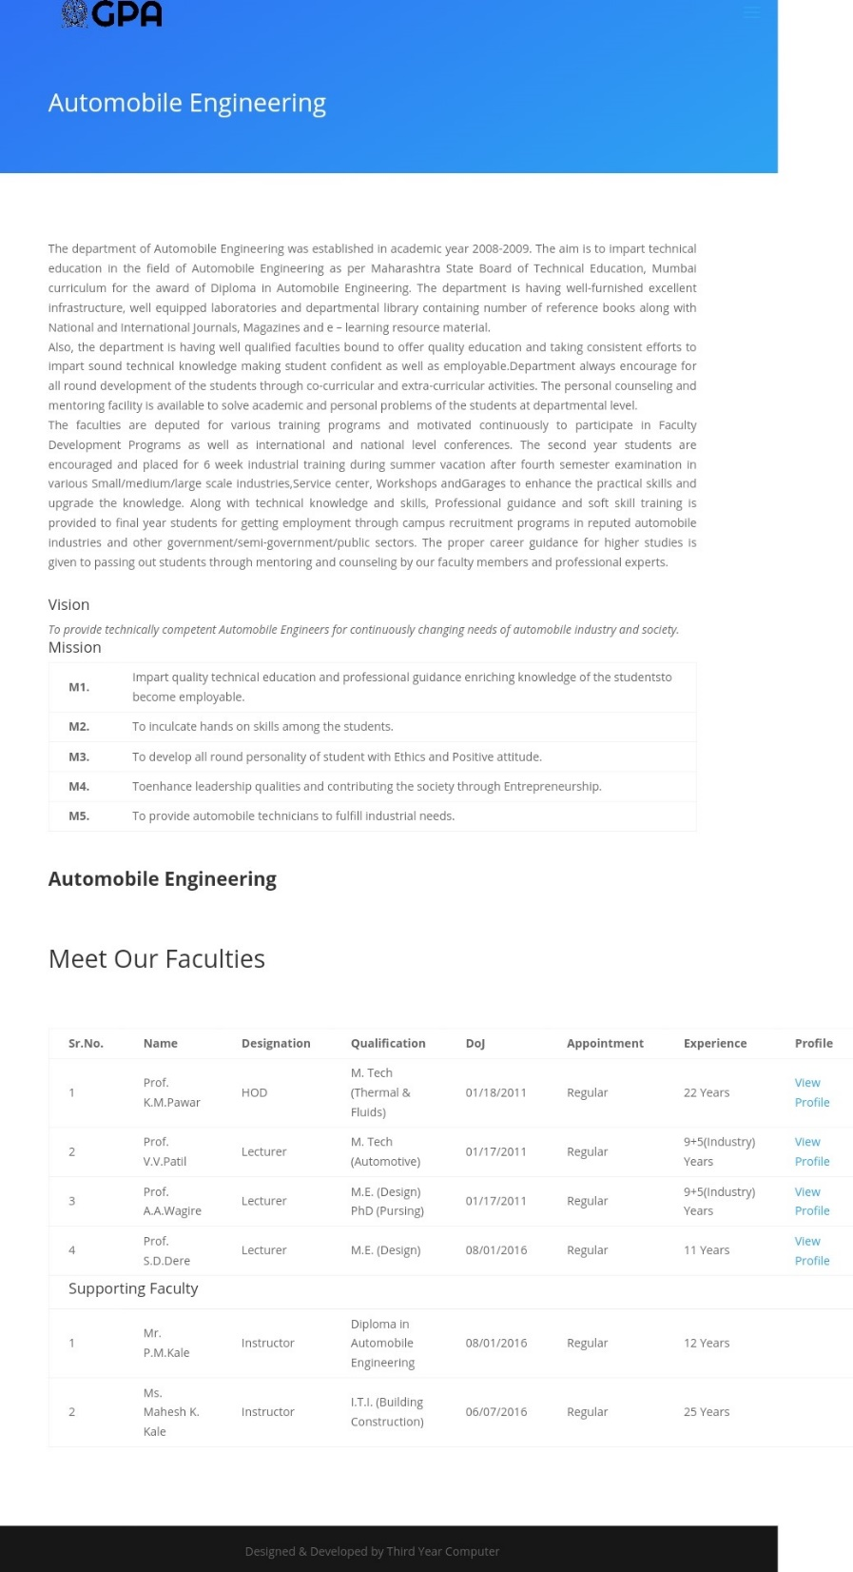

Slide 14
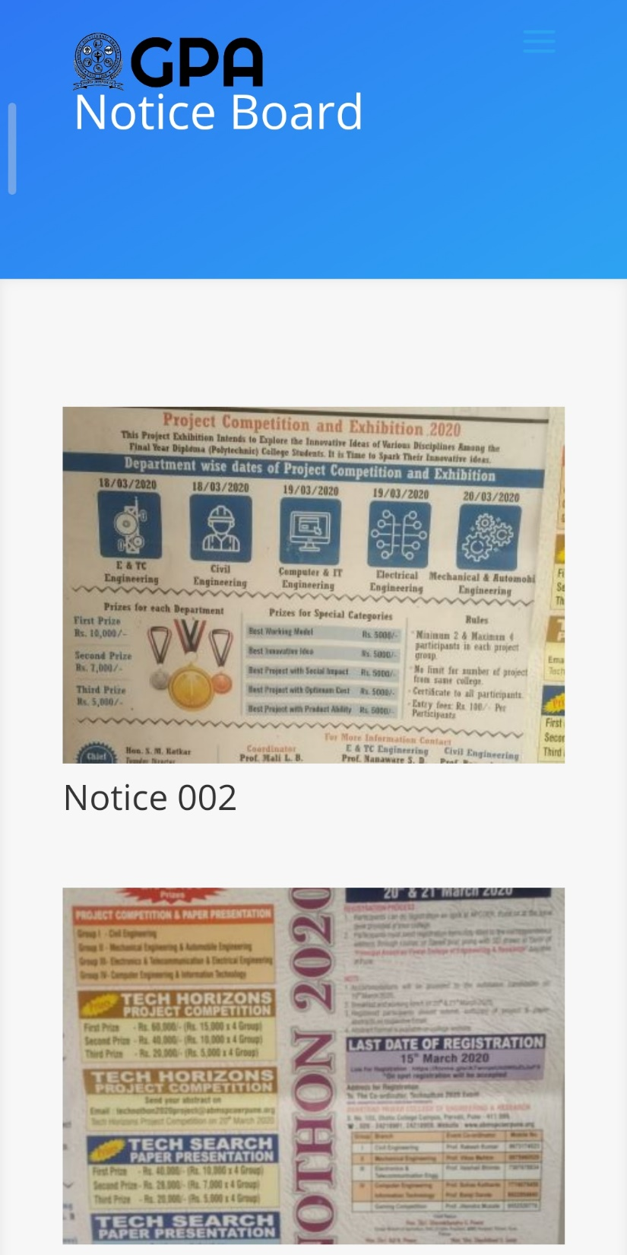
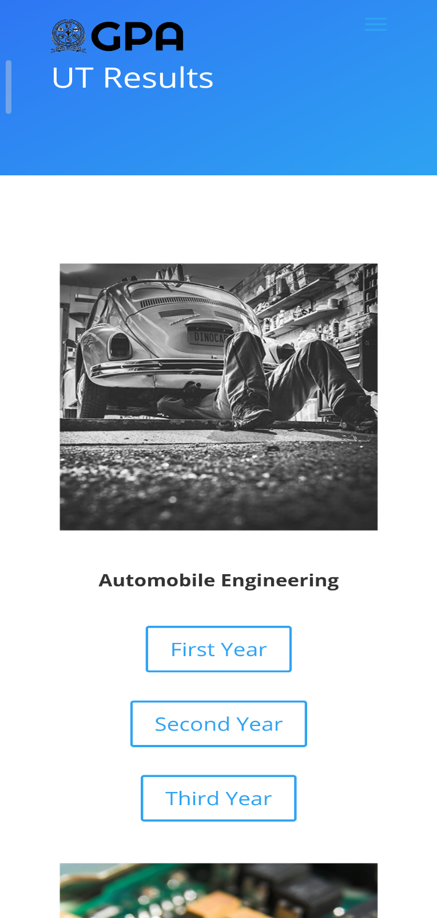

Slide 15
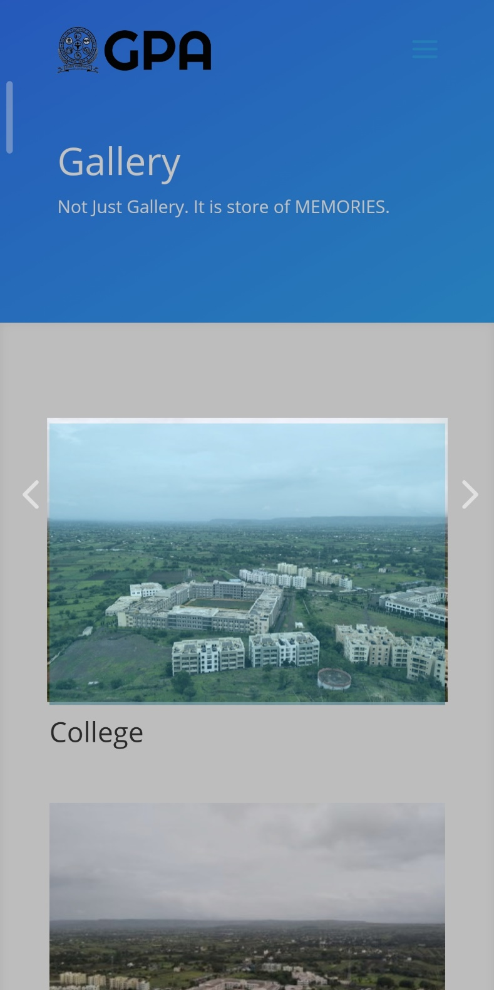
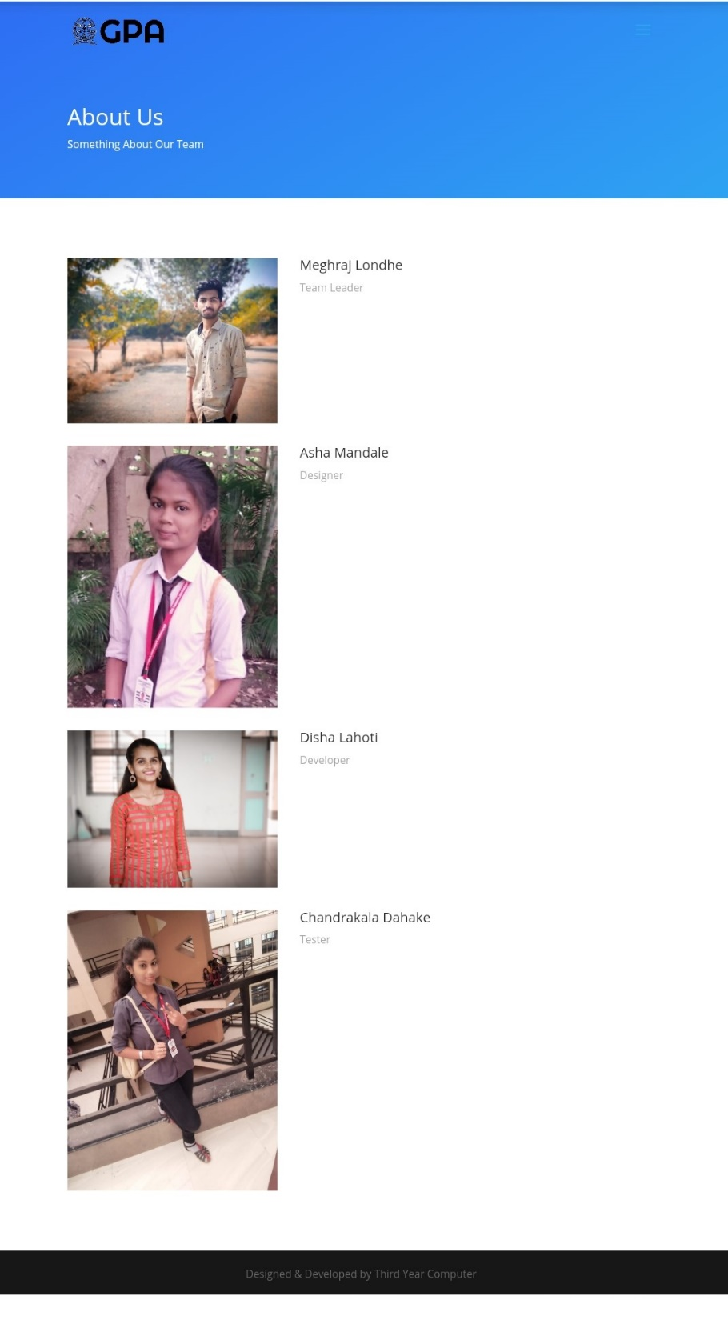

Slide 16
FUTURE IMPROVEMENT OF USER LOGIN :
For now, we are giving username and password to every staff member of the college but in next version we can give some high security.
That is only respected subject teacher can update the data, the others cannot update that data they can only read that data .
That means we will provide the different user login to different departments due to that the data will be more secured.
At last , we will provide the master user login.

Slide 17
Future Scope:
After Developing this application, we will give some more uses like the staff can add the attendance sheet by giving excel format.
Also we can add some additional database of staff.
We will try to add some scholarship related information there.
We are trying to add more admins to make it easy.
We will provide more dynamic changes to app.

Slide 18
Conclusion:-
In this way, we plan to develop the application for our college and also planned about the contents which we are going to add in this application. We will try the best to give the best application for our college which will convenient and user friendly to the non technical person also.

Slide 19
THANK YOU.

